Slide 1
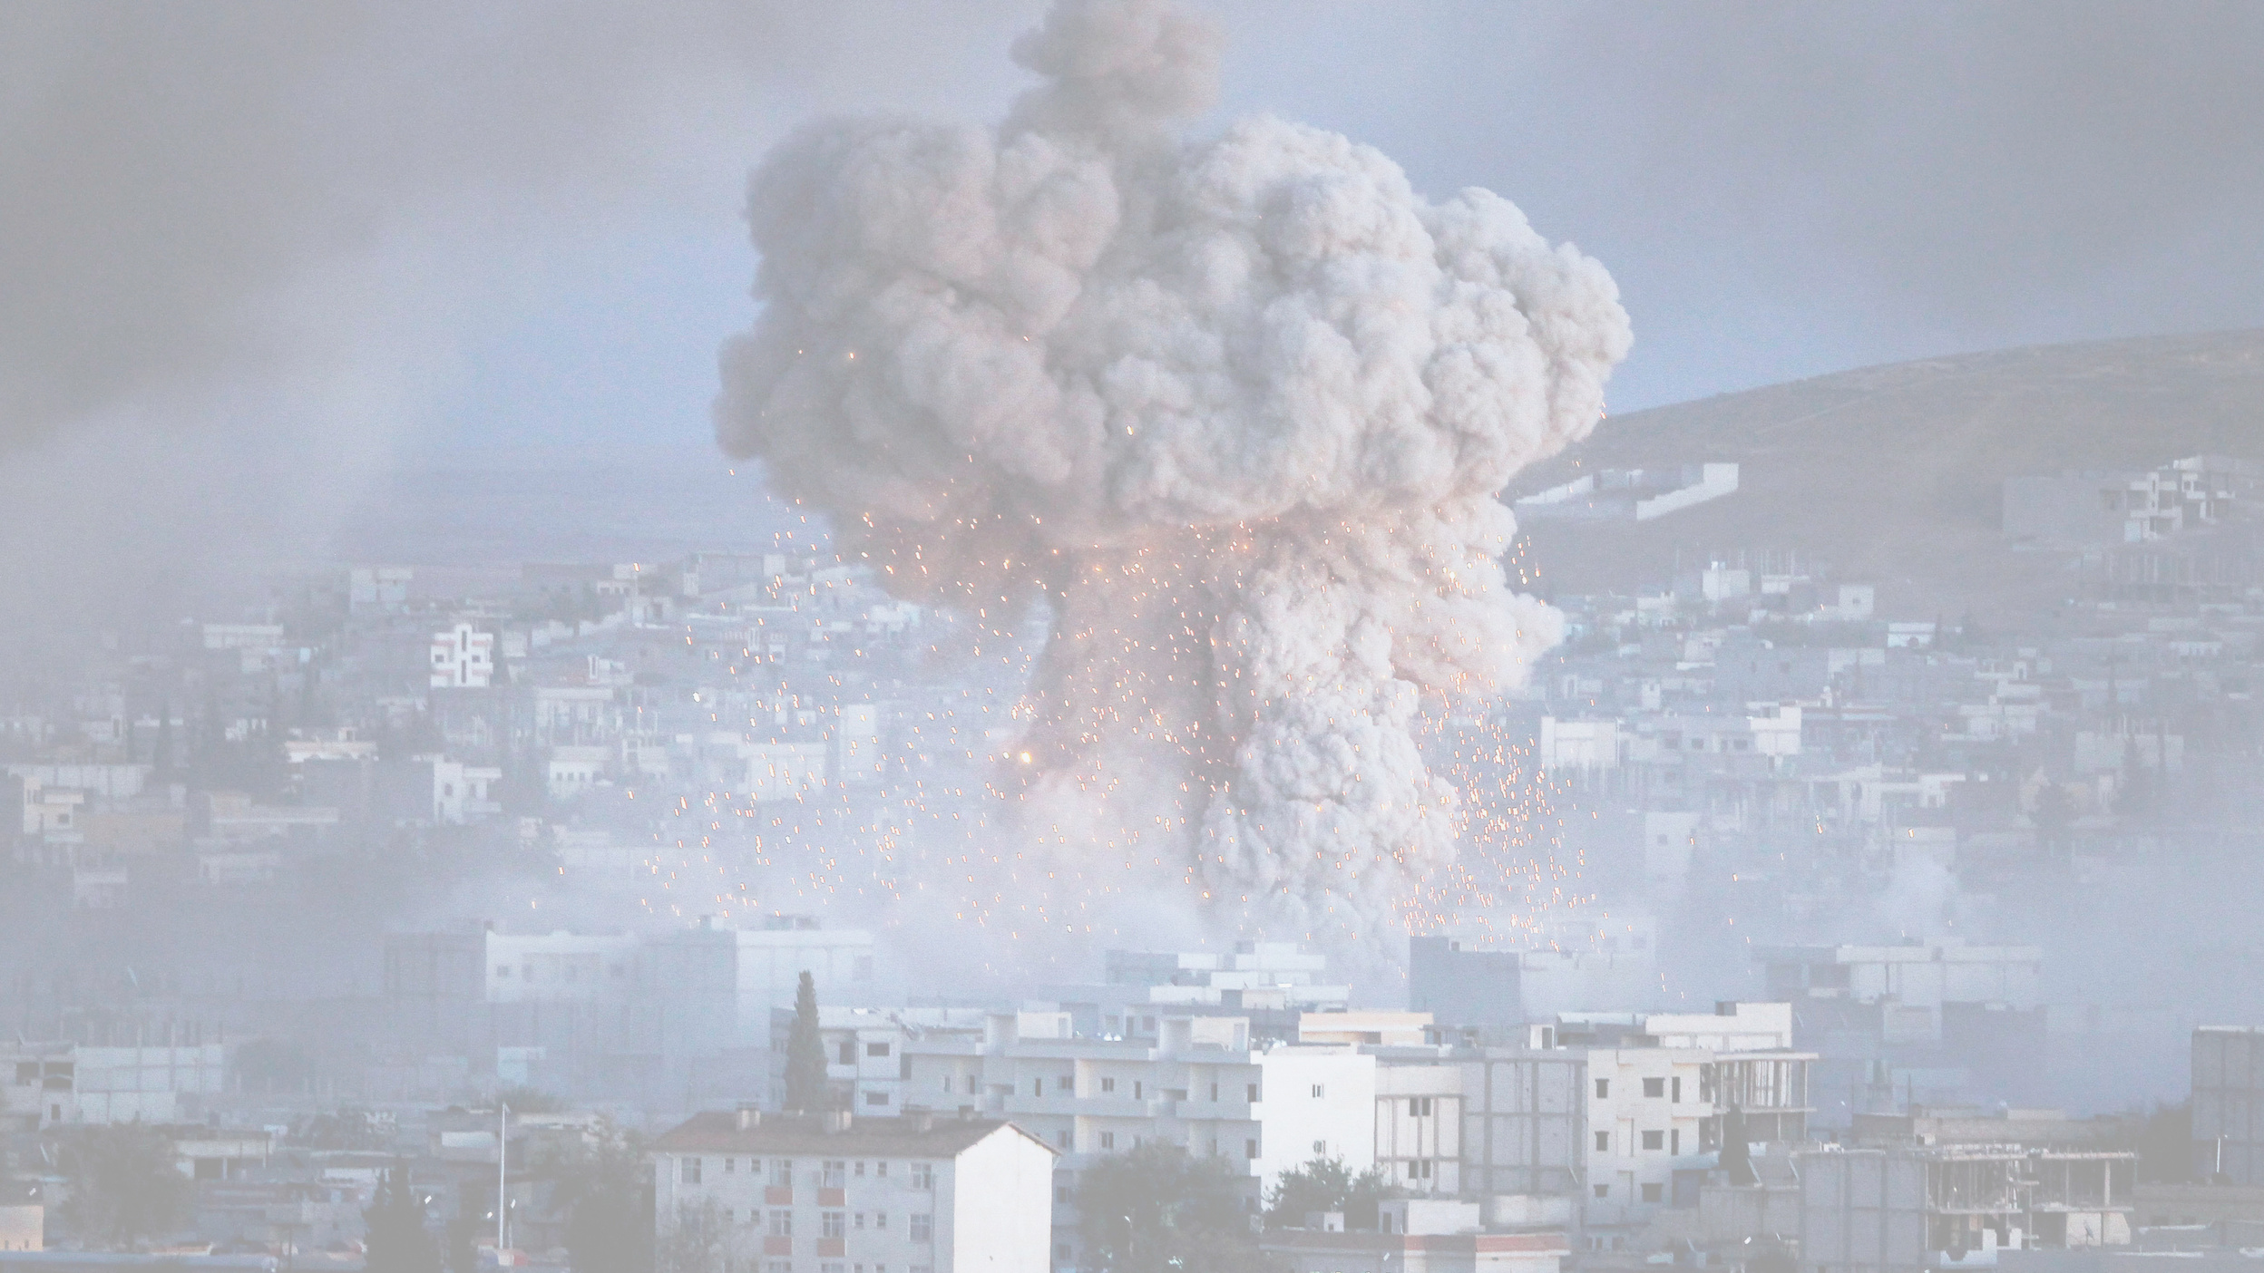
FIGHTING TERRORISM
DATA VISUALIZATION
Group 7 Project
Đàm Quang Đức
Vũ Hữu An
Trần Hữu Đạo
Nguyễn Trọng Tâm
Lại Trí Dũng
20225483
20225467
20220061
20225527
20225486
Page 1

Slide 2


TABLE OF CONTENTS
01
Introduction
Brief information about our work
02
Data Processing
Preparing raw data for analysis and visualizing
03
Data Stories
Dataflow or how we deliver our project
04
Conclusion
More ideas for the similar scenario
Page 2

Slide 3

01
ABOUT OUR STUDY
Aim of study:
Provide insight into the terrorism issue
Analyze trends of terrorist incidents
Reflect on national and international situations
Our target viewer:
Students exploring related research topics
People without domain-specific expertise
Page 3

Slide 4

01
DATASET
Global Terrorism Dataset
Contains 200,000 terrorist information.
Most comprehensive unclassified terrorist database.
Over 100,000 terror incidents recorded since 1970.
Each case includes up to 120 detailed variables.
Millions of news articles reviewed for data collection.
Page 4

Slide 5

02. DATA PREPROCESSING
• 🧾 Renamed columns for clarity
• 🔍 Selected relevant feature columns
• 🧹 Handled missing values (NaN)
• 🔧 Engineered new features
• 🌍 Standardized country names
nkill → total_killed
cleaned_data = data[[...]]
cleaned_data['city'].fillna('Unknown’)
casualties = total_killed + total_wounded
'West Germany' → 'Germany'
Page 5

Slide 6

03.DATA
FLOW
Page 6

Slide 7

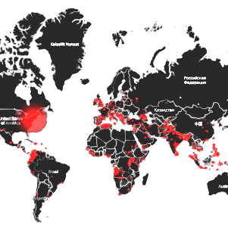


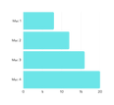
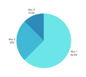
Why Terrorism?
Terrorism Status
Terrorism Information
What Terrorism?
Page 7

Slide 8
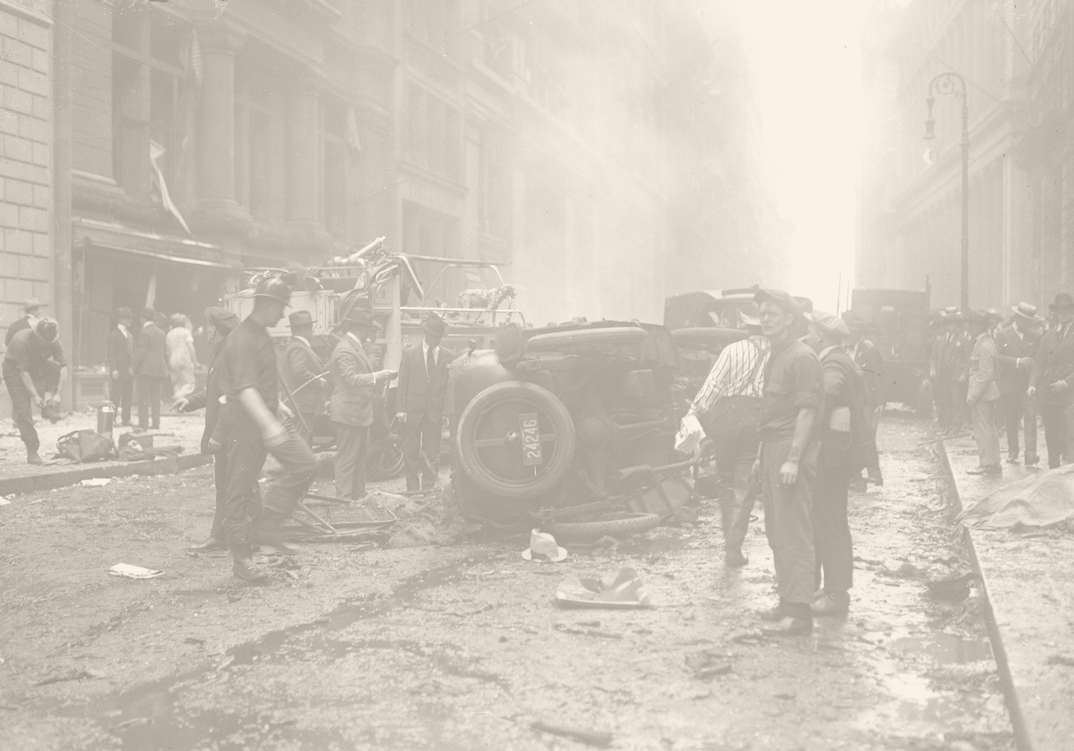
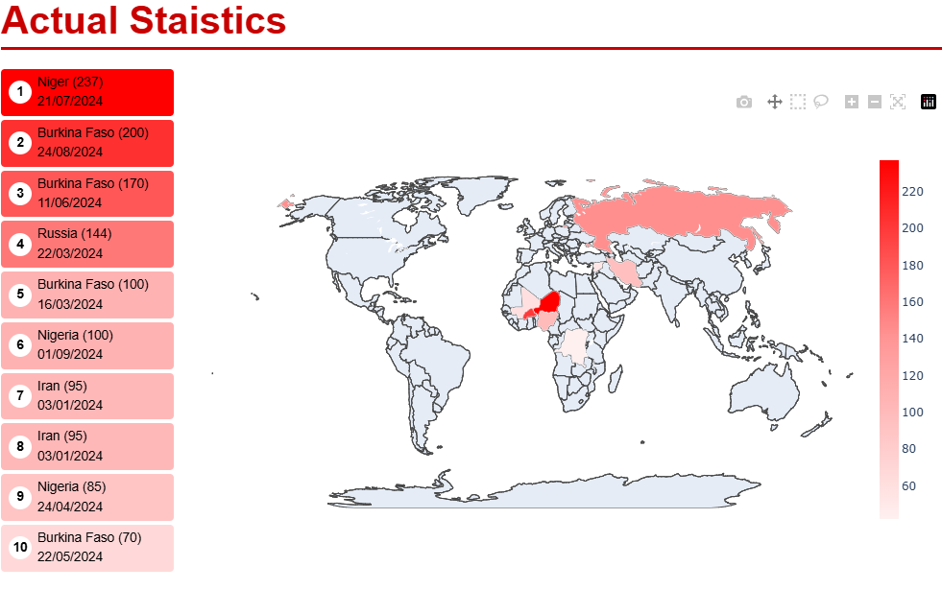
1. Why do we should pay attention to Terrorism?
Show severity of terrorist attacks by country
Convey clear sense of attack severity
Highlight panel on country selection engages viewers
Sidebar panels ease access to specific incidents
Page 8

Slide 9

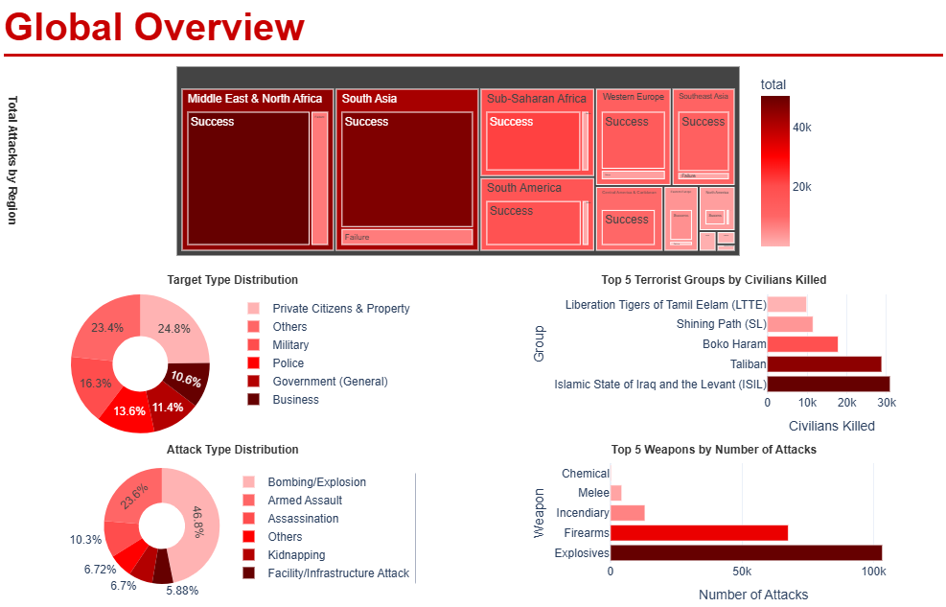
2. What is the basic information about Terrorism?
Show total attacks per region
Convey attack and target type distribution
Logical layout groups related charts
Custom red palette ensures consistency
Page 9

Slide 10

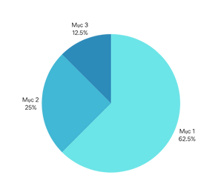
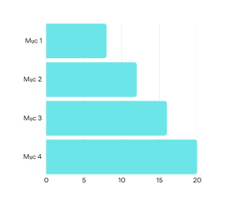


HOW IS THE AFFECTION OF TERRORISM?
Region
Data is analyzed based on different geographic regions.
Time
Data is analyzed based on different time stamps.
Quantitative
Presents key notable summary numbers.
Page 10

Slide 11

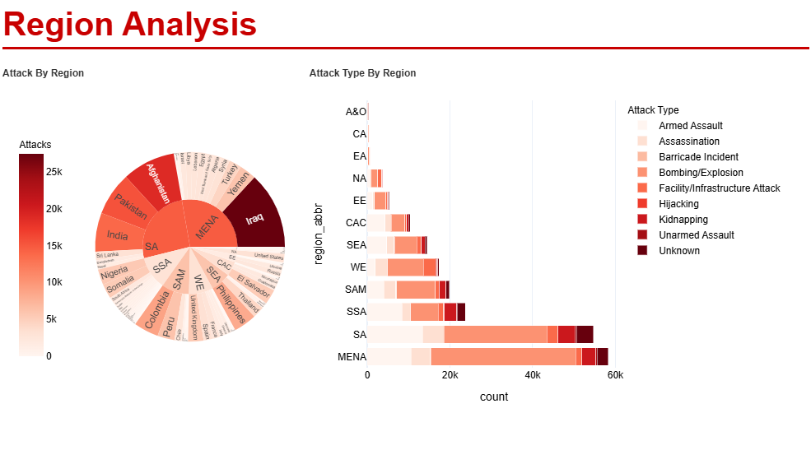
3. How does Terrorism distributed by region?
Show attack totals per region hierarchy
Display attack type distribution by region
Interactive sunburst reveals hierarchical region data
Stacked bar clearly compares attack types
Page 11

Slide 12
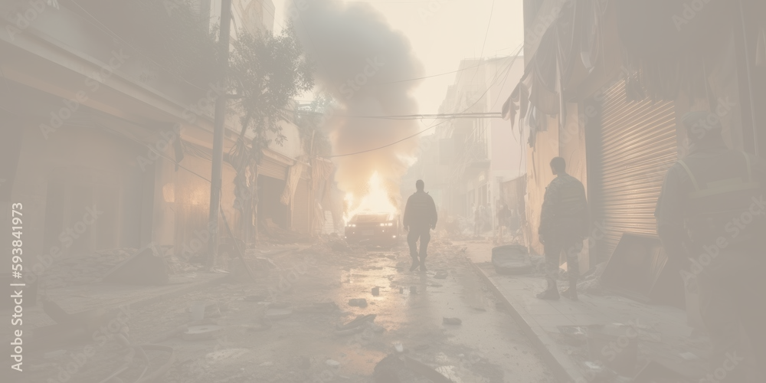
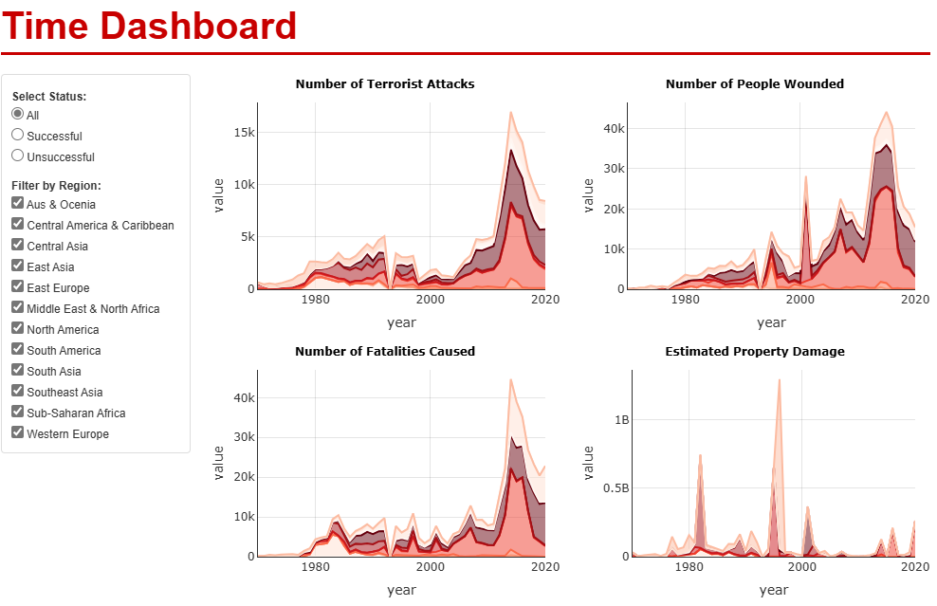
4. How does Terrorism distributed by time?
Show severity of terrorist attacks by country
Convey clear sense of attack severity
Highlight panel on country selection engages viewers
Sidebar panels ease access to specific incidents
Page 12

Slide 13

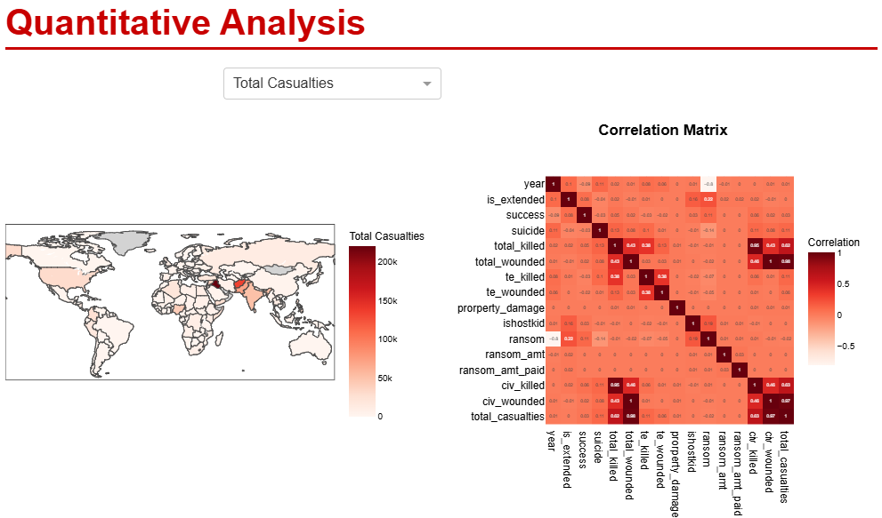
5. Some relevant information
Effective static and animated choropleth maps
Clean, modular code with interactive figure dropdown
Page 13

Slide 14

04.CONCLUSION
Page 14

Slide 15

WE HAVE ACHIEVED
Cleaned and standardized global terrorism dataset.
Engineered new insightful analytical features.
Learned how to use the dashboard.
Proposed a data processing pipeline.
Approached system design methodologies.
Page 15

Slide 16

THANK YOU
QUESTION TIME
Do you have any questions?
Page 16

